Slide 1
VICReg and related works
And Yann’s general opinions on SSL
(as remembered by Dan)

Slide 2
Roadmap
Intro: Yann’s 指点江山
VICReg
Related works

Slide 3
Self-supervise (自监督) = 👍 👍 👍
Because:
Data >> labels
We can pretrain + finetune/…

Slide 4
How to pretrain w/自监督?
Representation learning.
How to learn representations?
Pretext tasks.
E.g. LM, denoising, colorization, joint embedding methods…
What pretext task?
Joint embedding method (JEM).

Slide 5
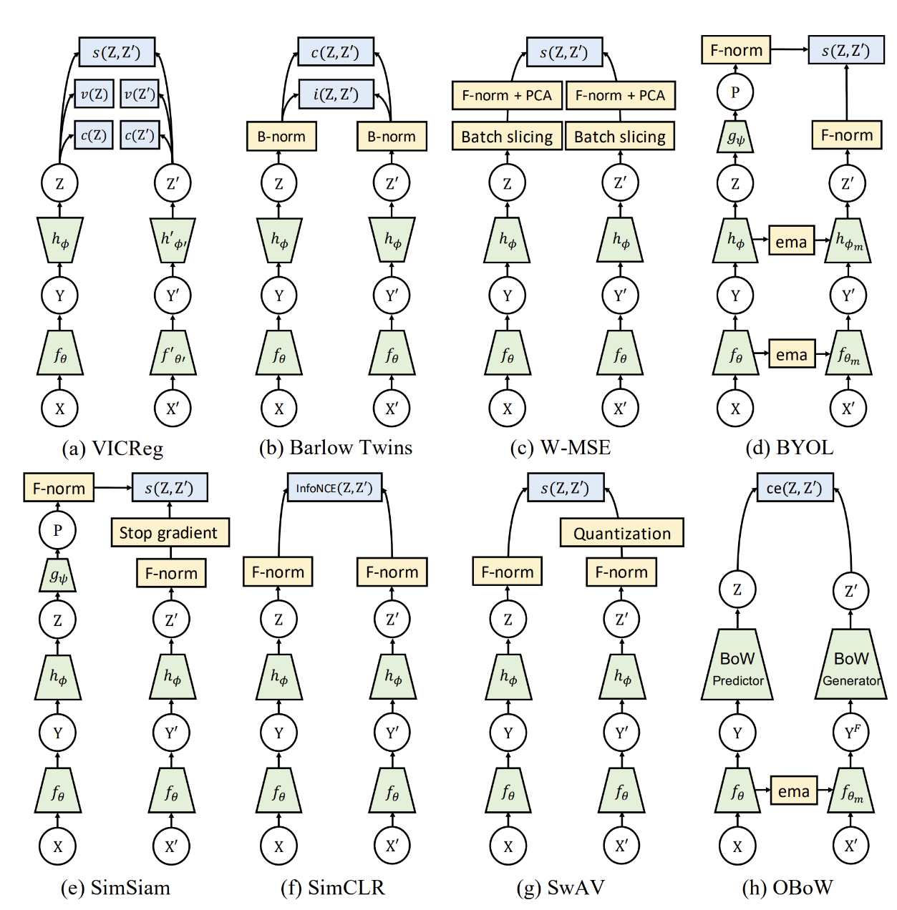
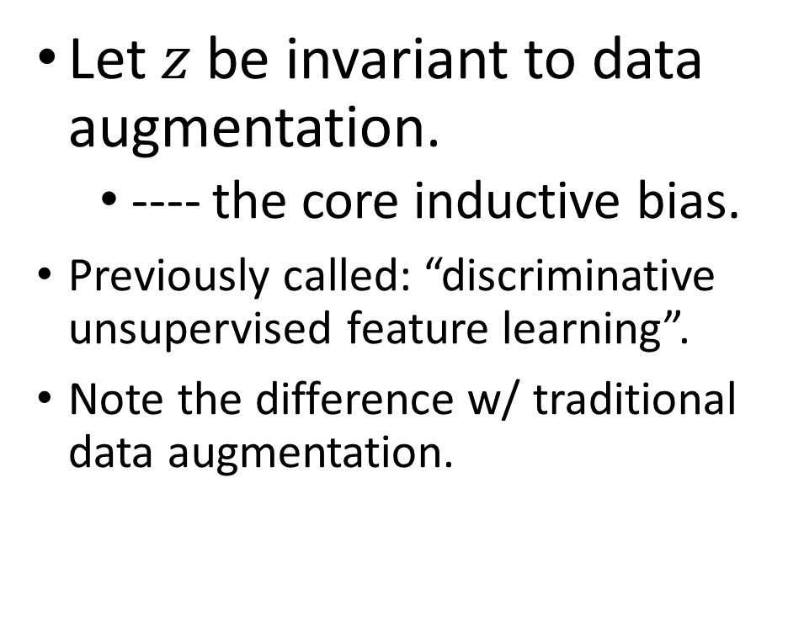
Joint embedding method (JEM) = 👍 👍 👍
Let $z$ be invariant to data augmentation.
---- the core inductive bias.
Previously called: “discriminative unsupervised feature learning”.
Note the difference w/ traditional data augmentation.

Slide 6
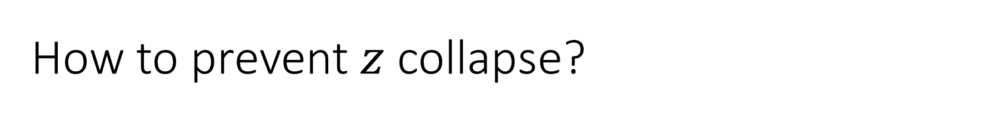
How to prevent $z$ collapse?
Decode.
Contrastive methods.
Negative pairs from dataset. (SimCLR’s NT-Xent, infoNCE, …)
Architectural methods.
Regularization.
VICReg.

Slide 7
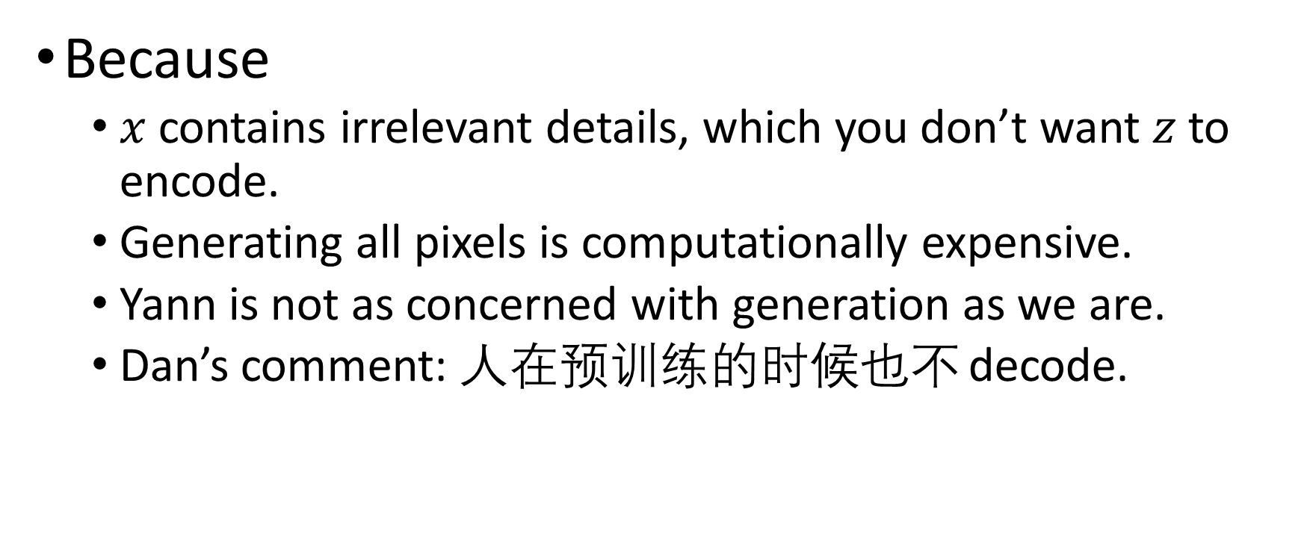
Decode = 👎 👎 👎
Because
$x$ contains irrelevant details, which you don’t want $z$ to encode.
Generating all pixels is computationally expensive.
Yann is not as concerned with generation as we are.
Dan’s comment: 人在预训练的时候也不 decode.

Slide 8
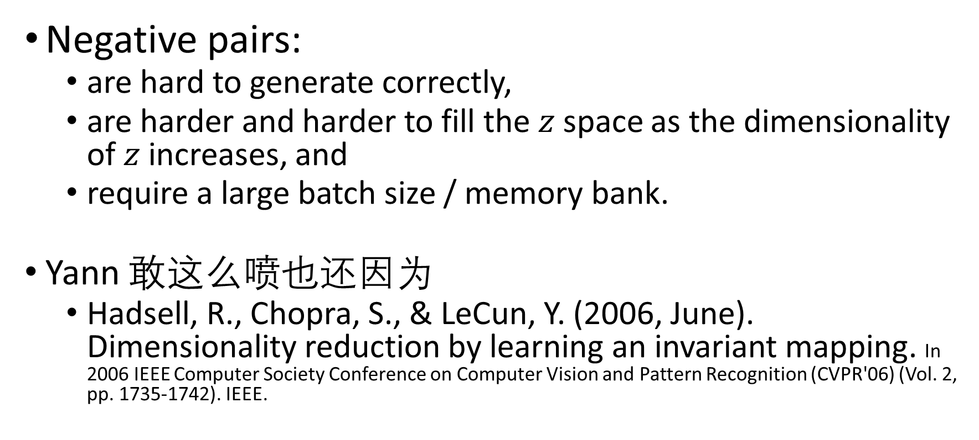
Contrastive methods = 👎 👎 👎
Negative pairs:
are hard to generate correctly,
are harder and harder to fill the $z$ space as the dimensionality of $z$ increases, and
require a large batch size / memory bank.
Yann 敢这么喷也还因为
Hadsell, R., Chopra, S., & LeCun, Y. (2006, June). Dimensionality reduction by learning an invariant mapping. In 2006 IEEE Computer Society Conference on Computer Vision and Pattern Recognition (CVPR'06) (Vol. 2, pp. 1735-1742). IEEE.

Slide 9
Metric Learning VS Contrastive JEM
Metric learning.
Supervised. Same label -> attract. Different labels -> repel.
“instance as class”
---- is how some papers frame the contrastive method.
想要利用 “instance as class” 在自监督地做 “metric learning”, 你需要 data augmentation 和 contrastive method.
还有其他的可能性，e.g. music 起承转合。

Slide 10
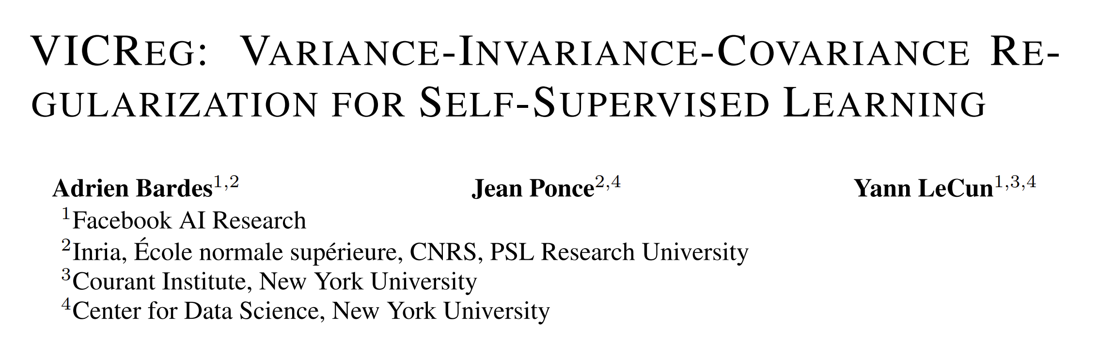

Slide 11
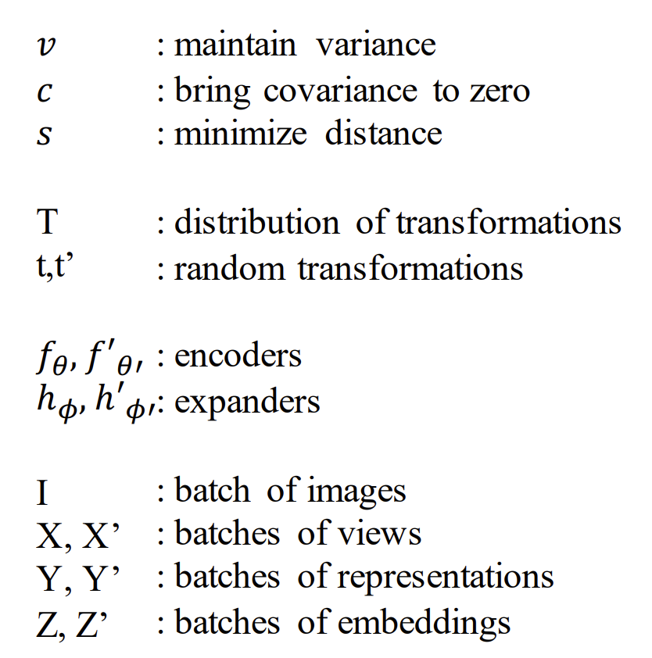
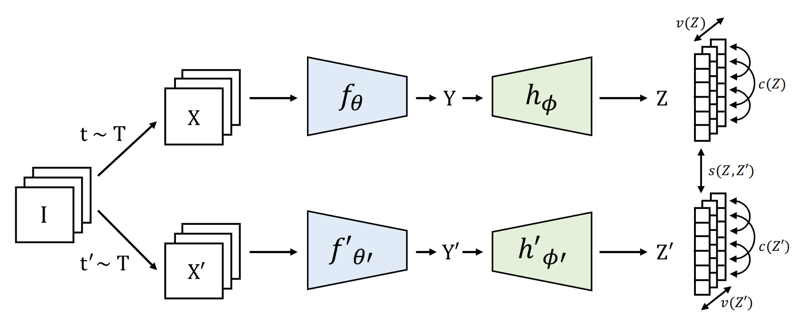
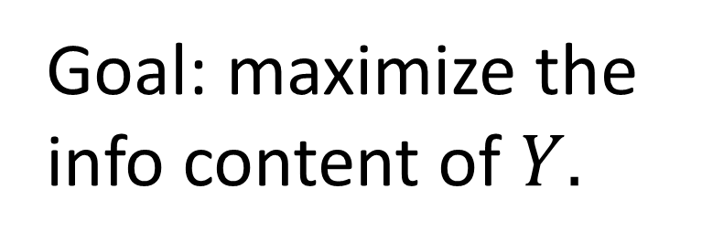
Goal: maximize the info content of $Y.$

Slide 12
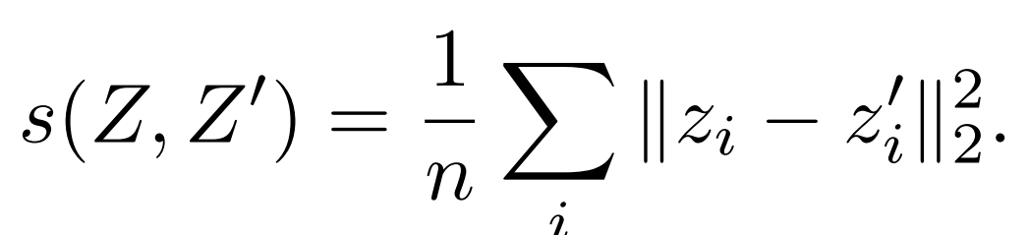
Invariance

Slide 13
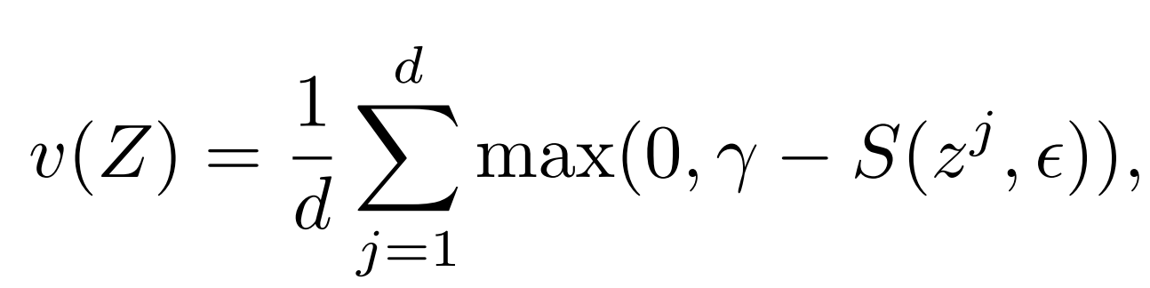
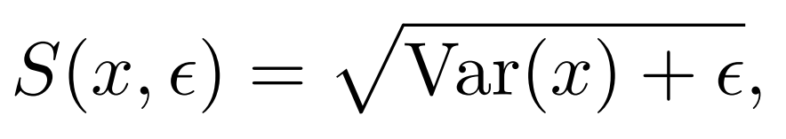
Variance

Slide 14
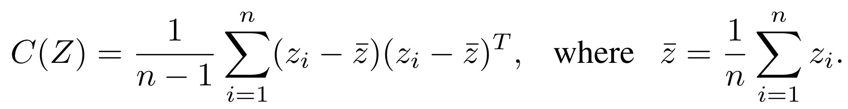
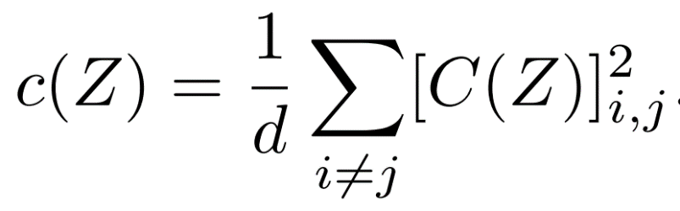
Covariance

Slide 15
I
V
C

Slide 16
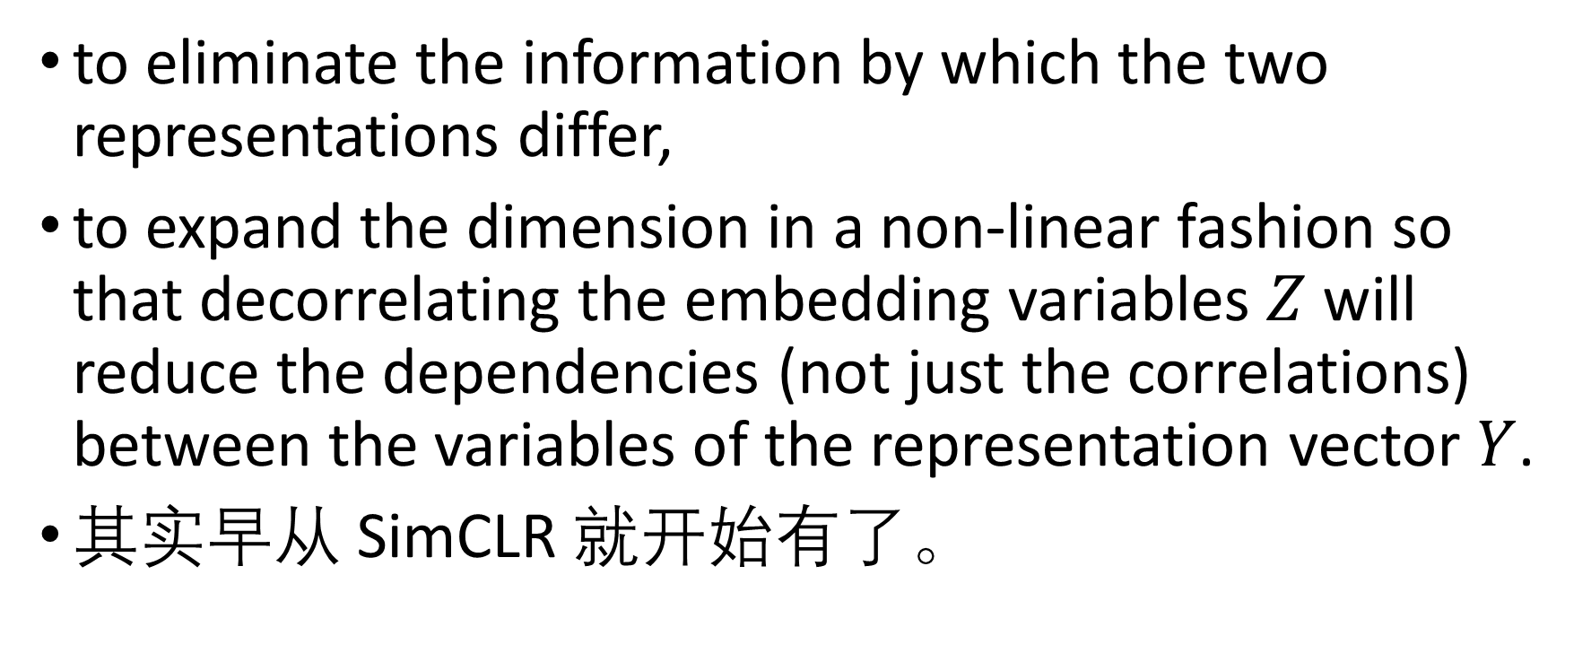
Why expander?
to eliminate the information by which the two representations differ,
to expand the dimension in a non-linear fashion so that decorrelating the embedding variables $Z$ will reduce the dependencies (not just the correlations) between the variables of the representation vector $Y$.
其实早从 SimCLR 就开始有了。

Slide 17
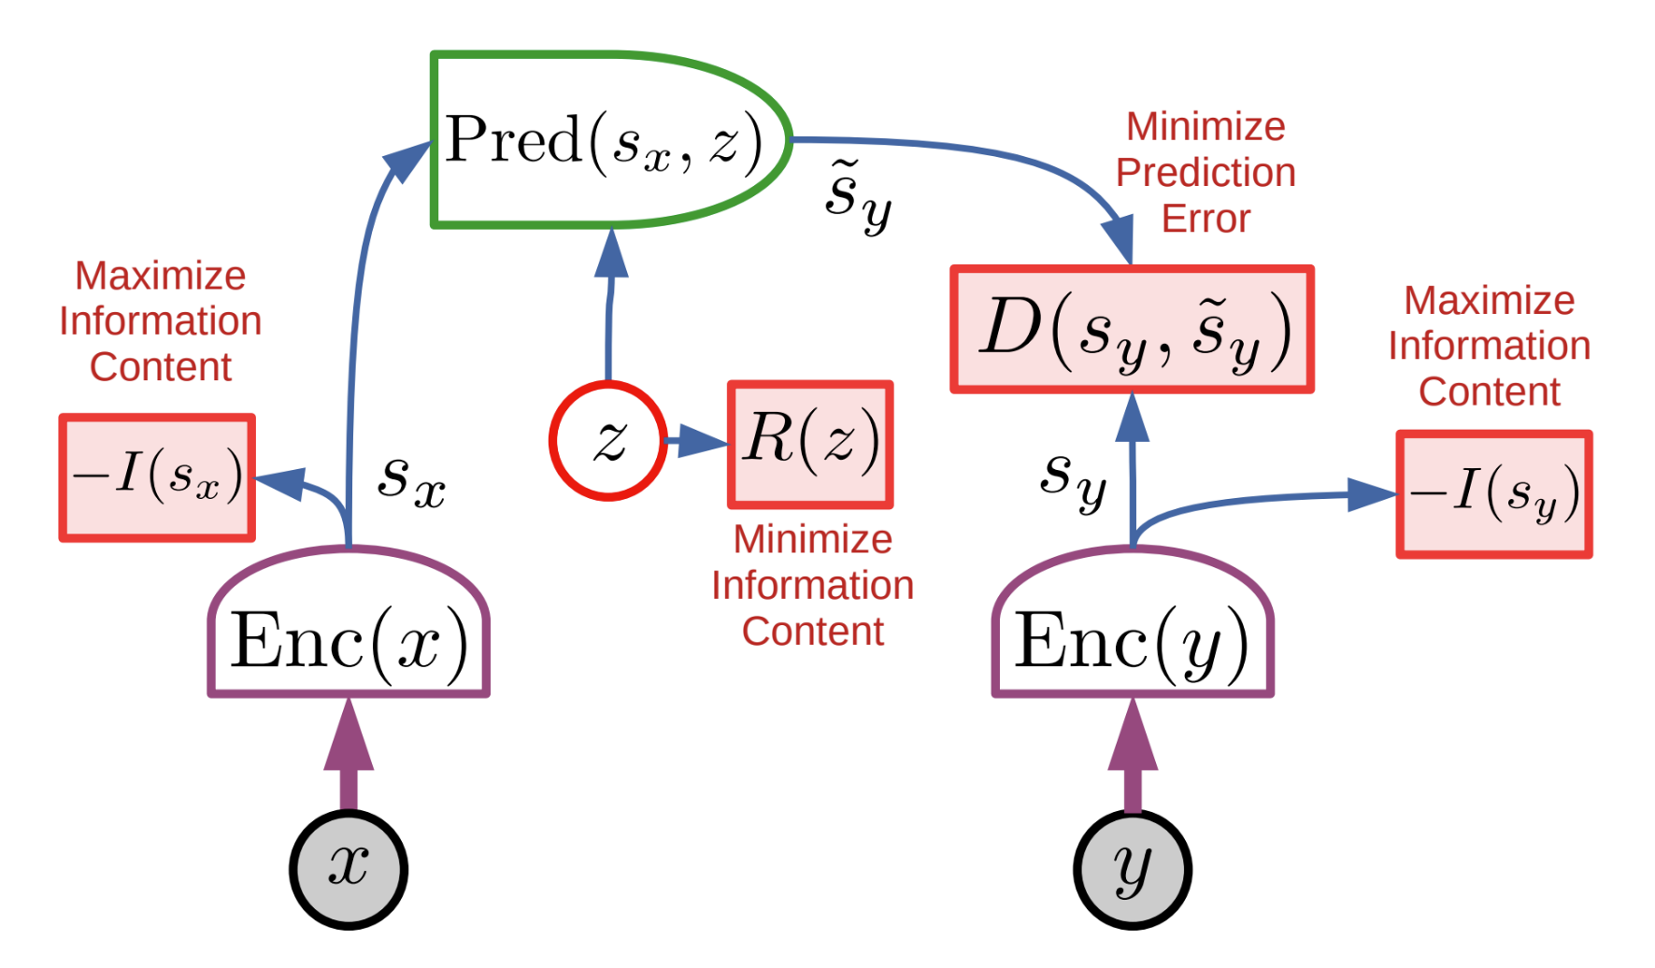
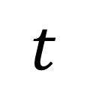
VICReg + JEPA
Without VICReg: collapse.
?
?
?
$$t$$

Slide 18
VICReg + JEPA
Without VICReg: collapse.
VICReg: maximize info content.
Overall effect: encode whatever’s predictable.
抓住规律。
Perception 会无视 the unpredictable.
?
$$t$$

Slide 19
VICReg + JEPA
Without VICReg: collapse.
VICReg: maximize info content.
Overall effect: encode whatever’s predictable.
抓住规律。
Perception 会无视 the unpredictable.
$$t$$

Slide 20
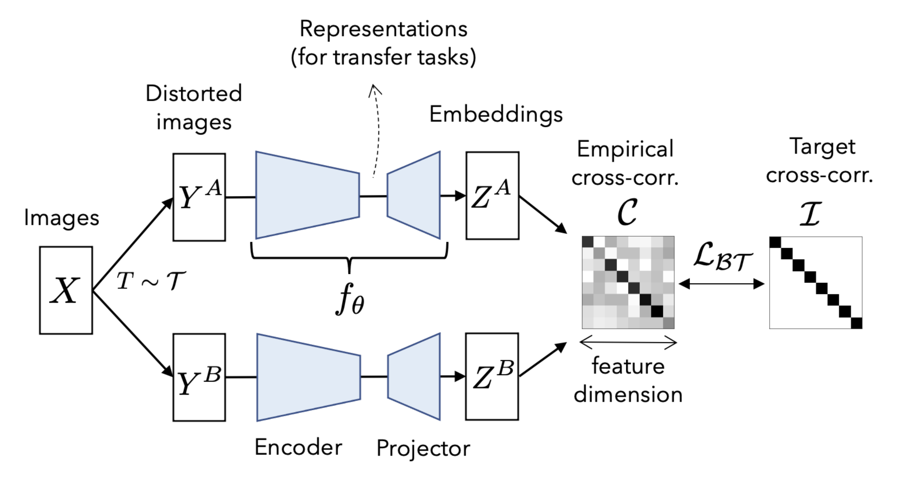
Barlow Twins
Diff w/ VICReg:
Cross-corr. of A and B

Slide 21
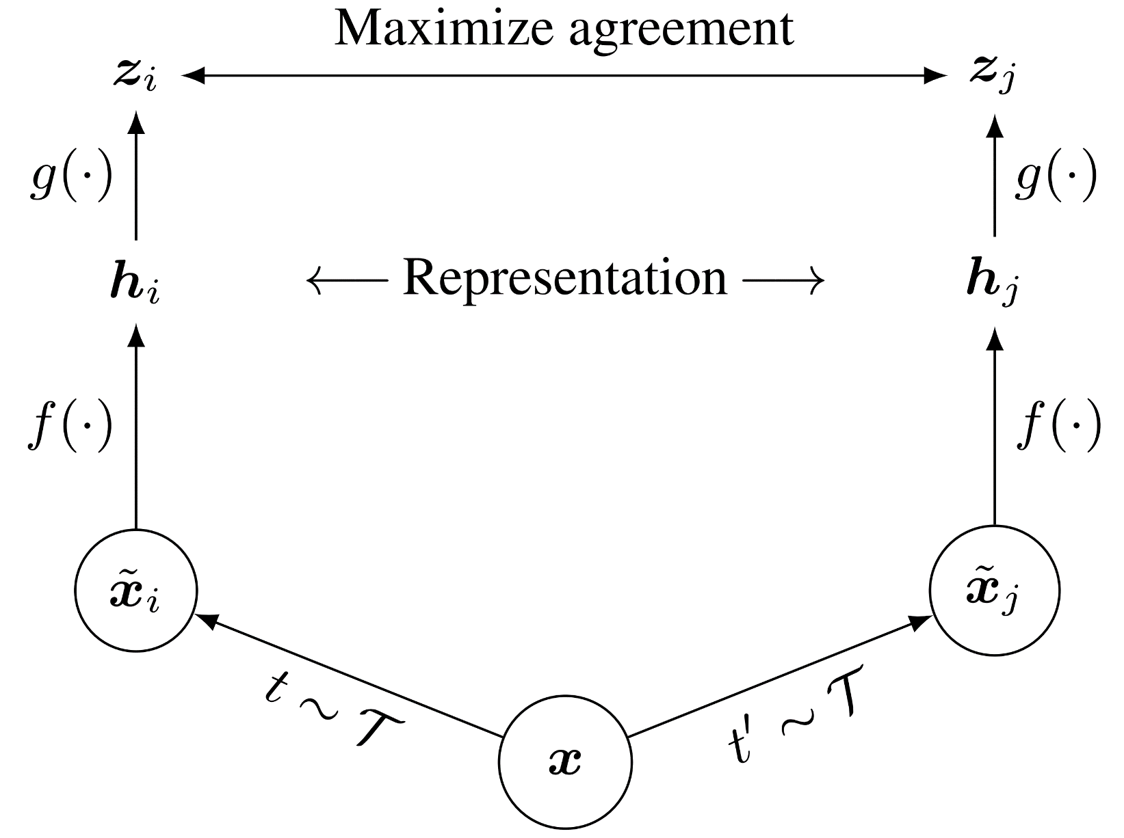
SimCLR

Slide 22
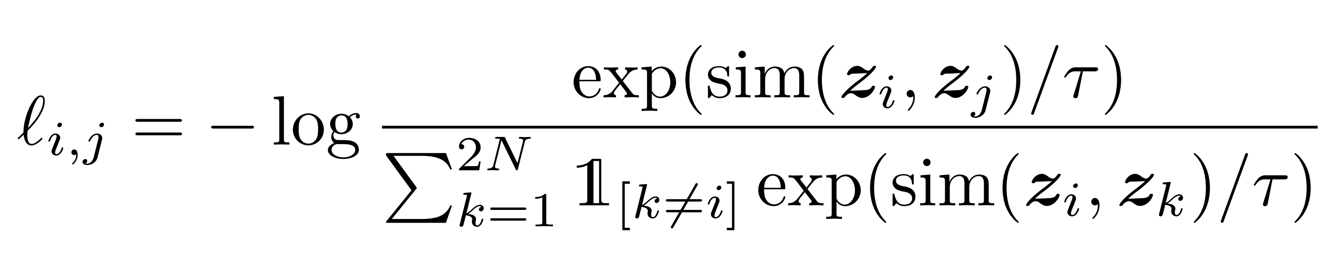
SimCLR
VICReg 提升 batch variance.
SimCLR 在 unit sphere 两两互斥，for every pair in a batch.

Slide 23
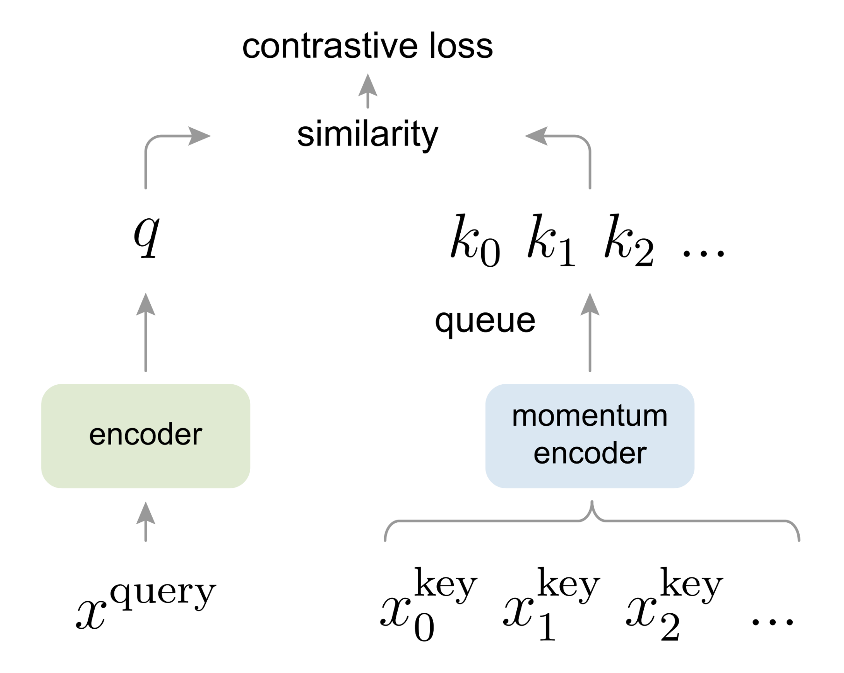
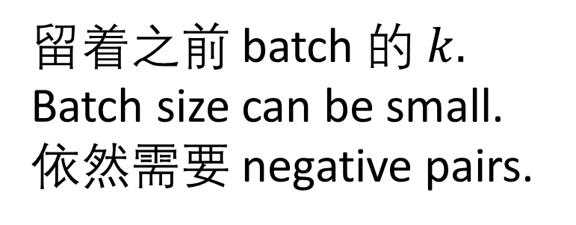
MoCo
留着之前 batch 的 $k.$
Batch size can be small.
依然需要 negative pairs.

Slide 24
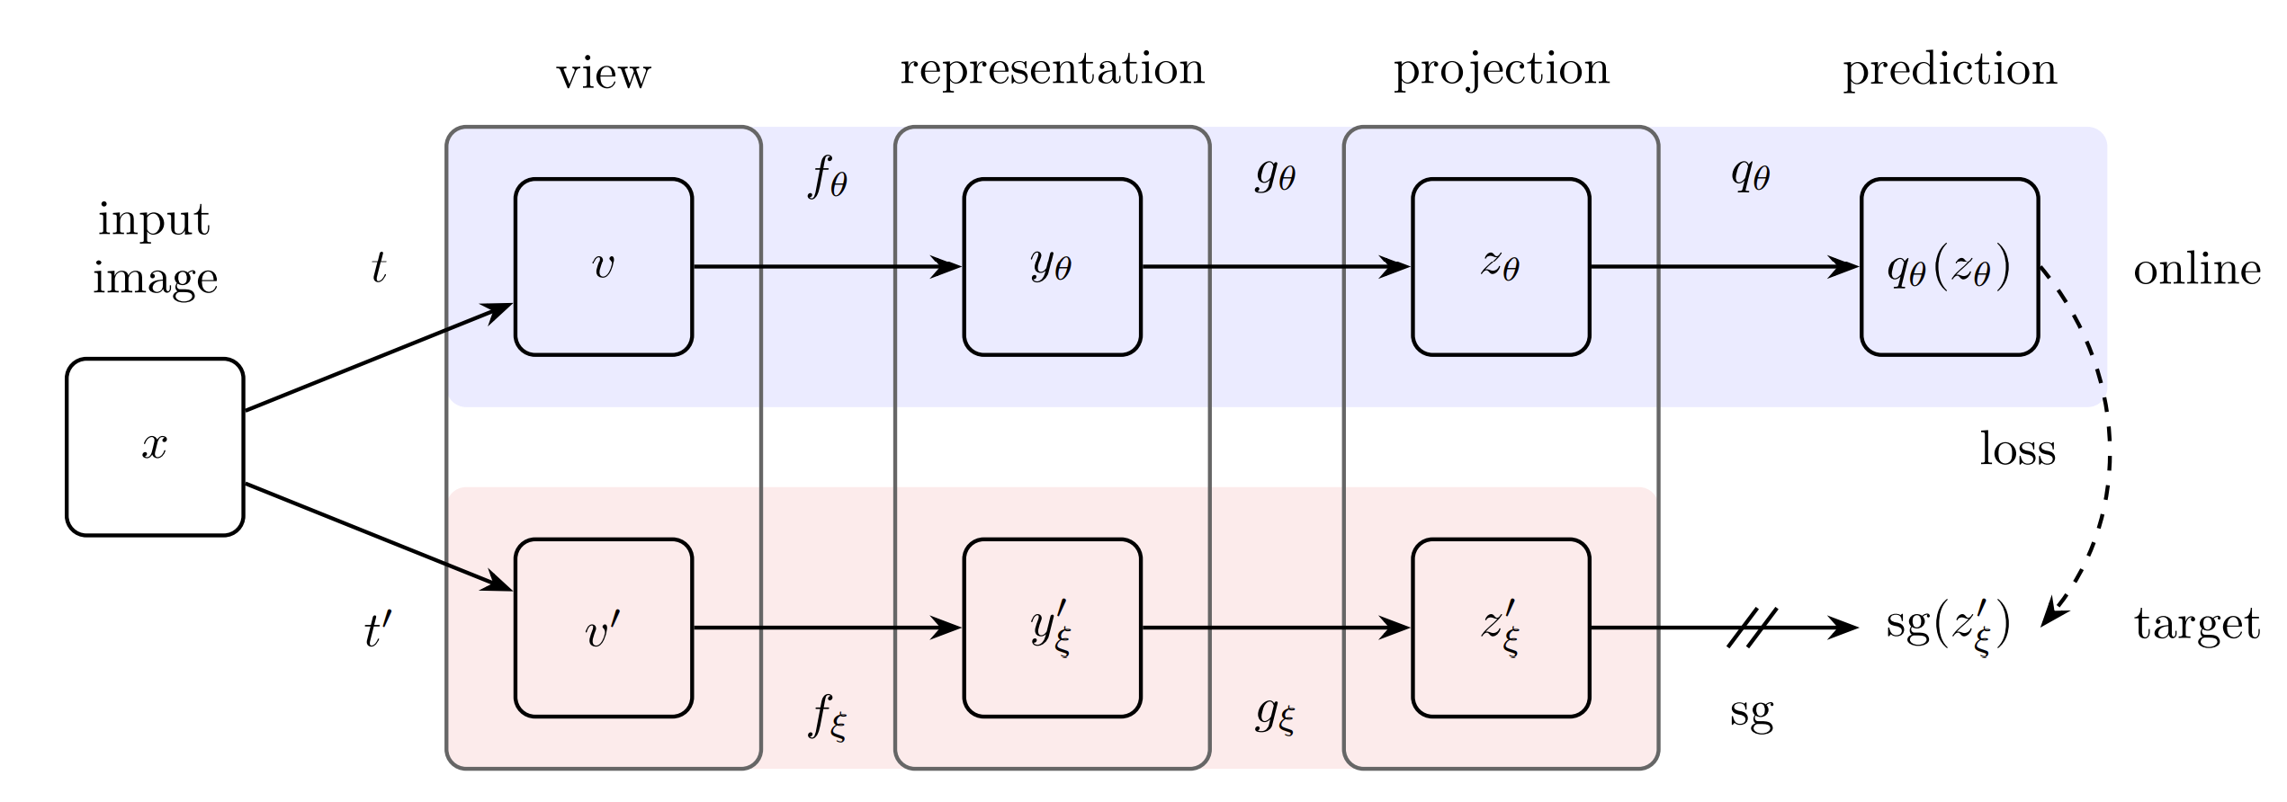
BYOL
Branch asymmetry.
Momentum encoder.

Slide 25
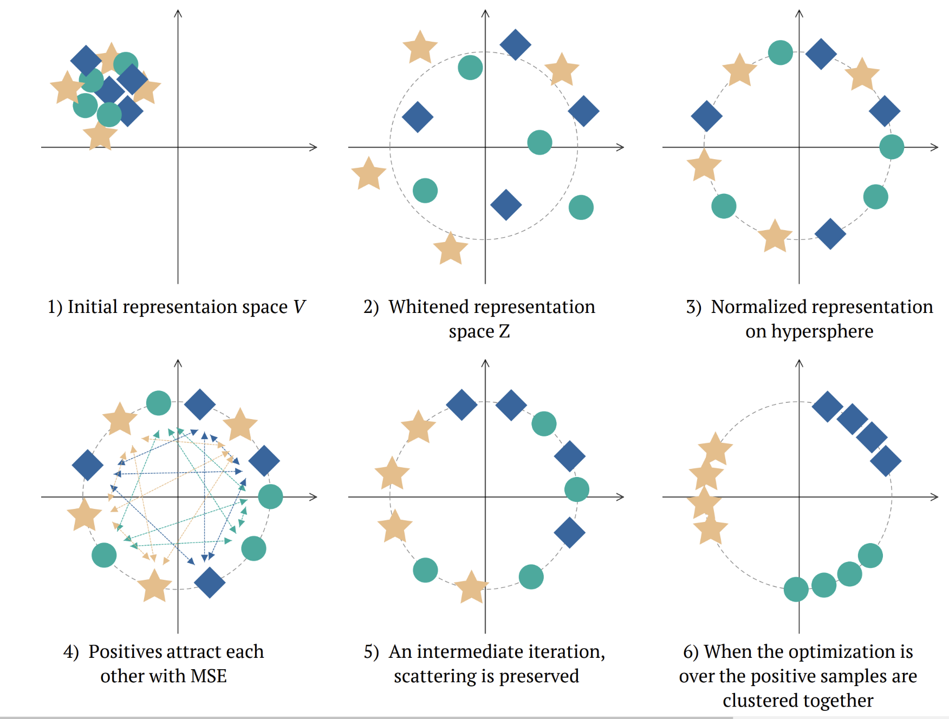

W-MSE
“BYOL可能是用了BN才work的。让我们只 whiten $z$ 试试。”

Slide 26
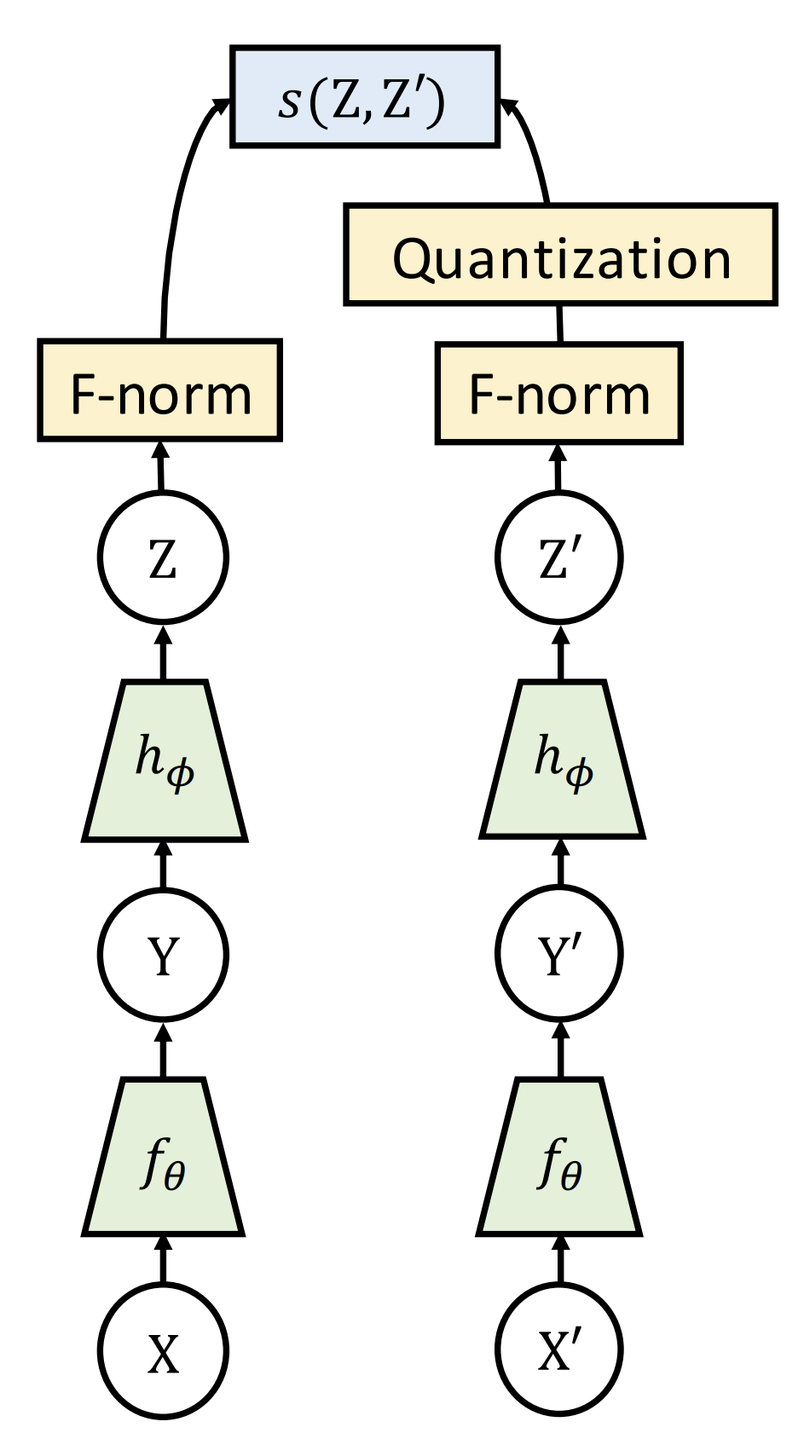
SwAV
Clustering 自带了 stop-grad.
猜猜全称是啥

Slide 27
SwAV
Clustering 自带了 stop-grad.
Swapping Assignments between multiple Views of the same image

Slide 28
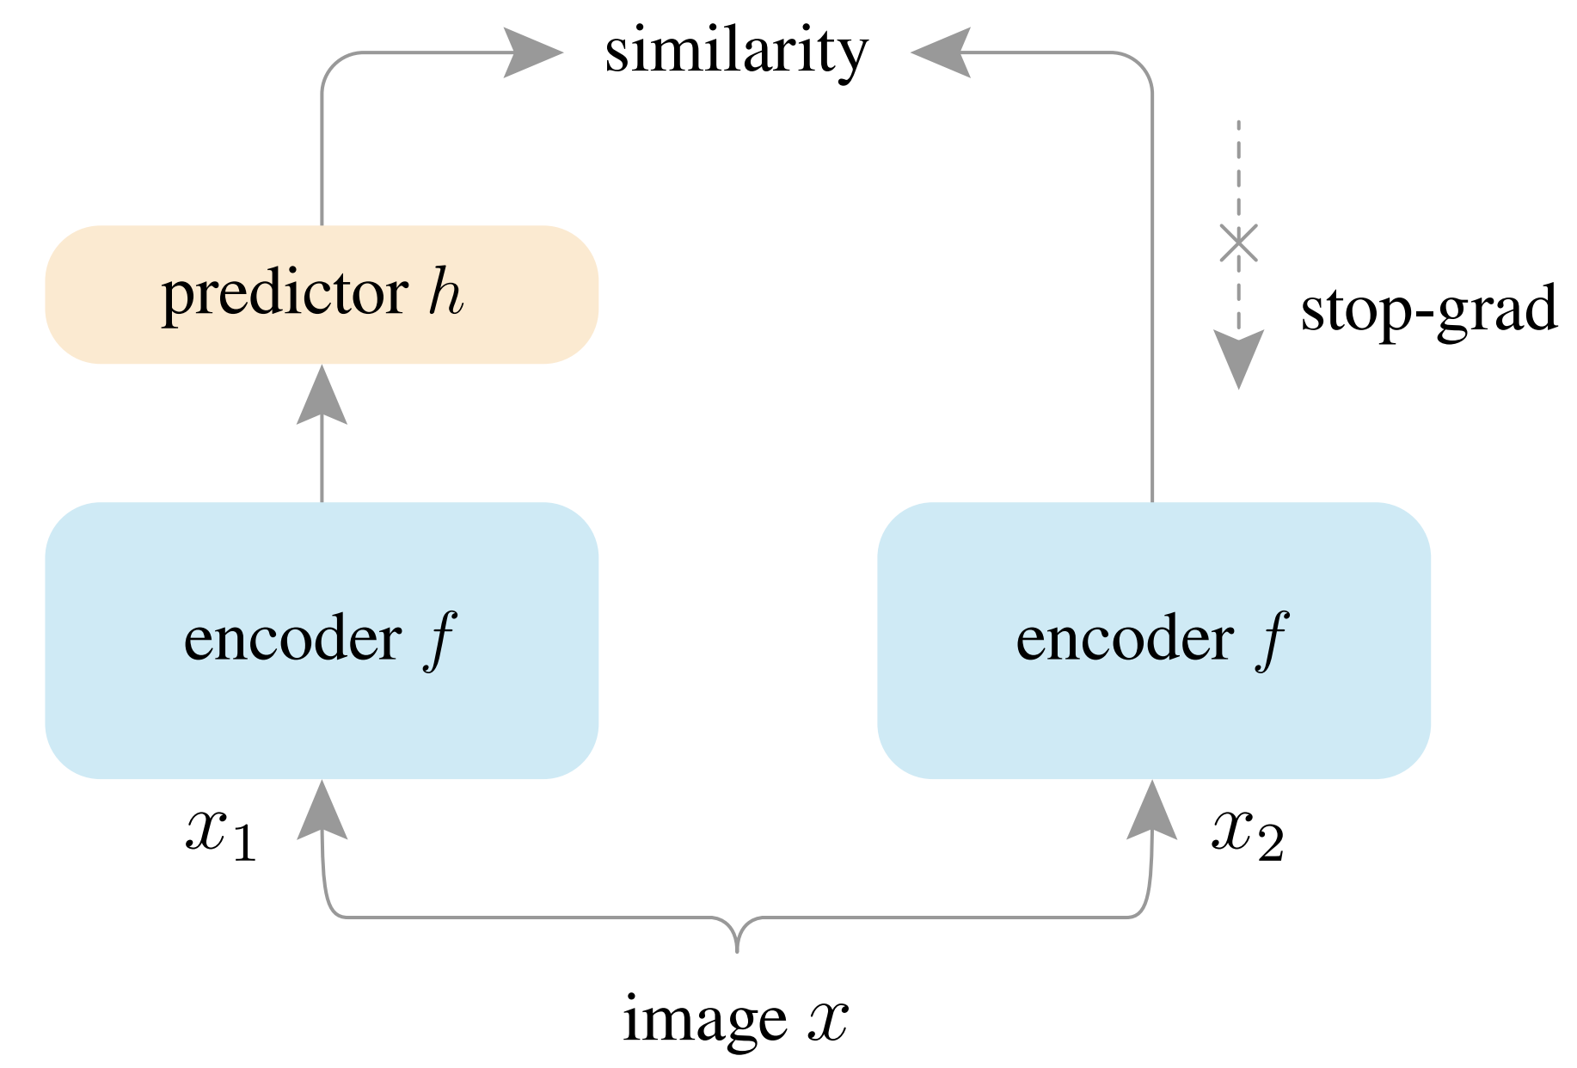
SimSiam
Stop grad is all you need.
你们没 ablate 掉的我帮你们 ablate 了。
有趣的是，之前的结果也做了 ablation 实验，没 ablate 掉。
“BYOL without momentum encoder. SimCLR without negative samples. SwAV without online clustering.”

Slide 29
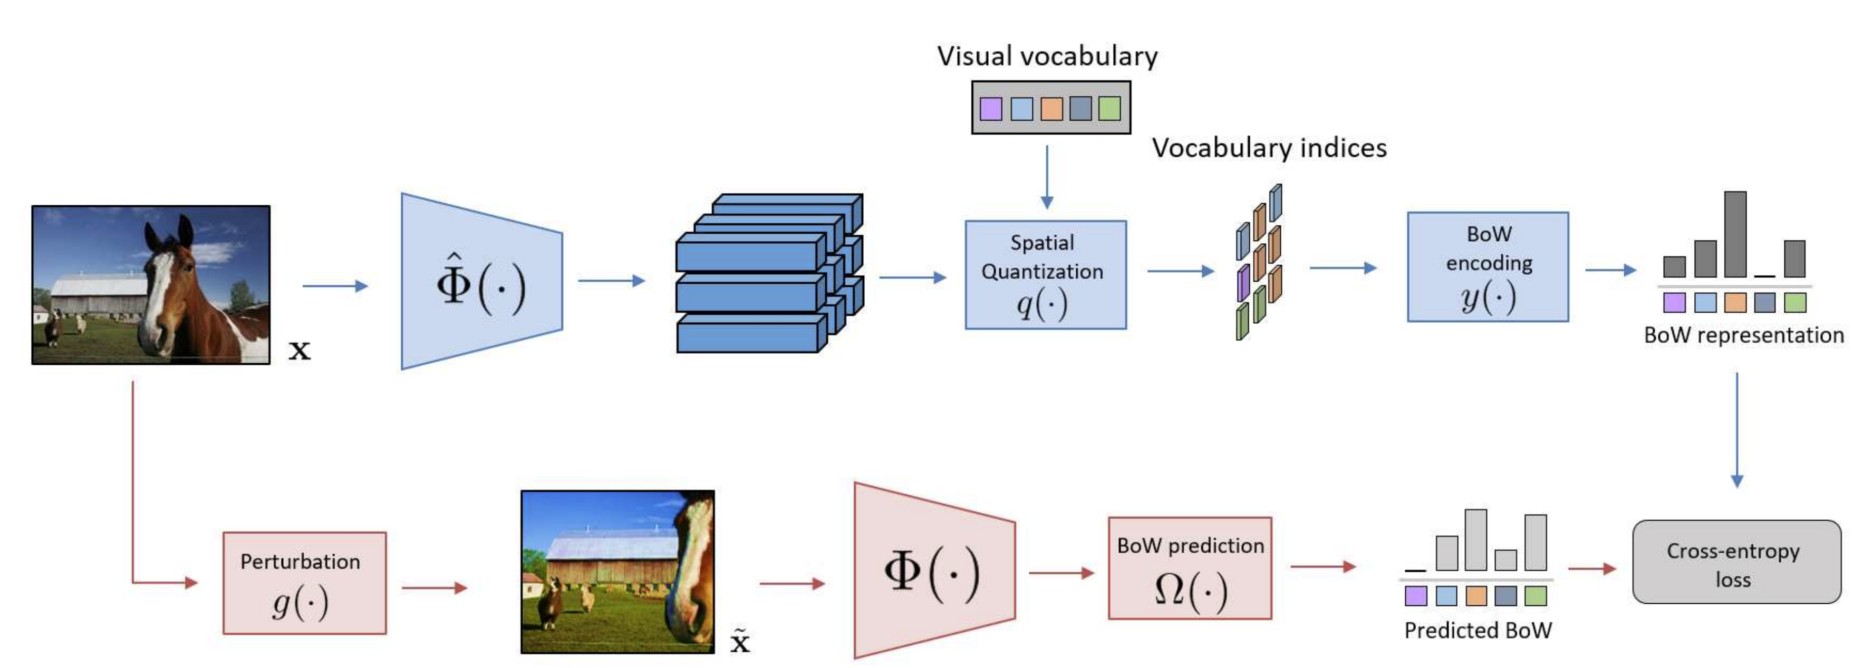
OBoW

Slide 30
VICReg
does not require that the weights of the two branches be shared, not that the architectures be identical, nor that the inputs be of the same nature;
Like CLIP, but without negative pairs. See Table 3.
does not require a memory bank, nor contrastive samples, nor a large batch size;
does not require batch-wise nor feature-wise normalization; and
does not require vector quantization nor a predictor module.

Slide 31
Experiments:
Compares performance of downstream tasks with frozen representations.

Slide 32
Bib
Bardes, A., Ponce, J., & LeCun, Y. (2021). Vicreg: Variance-invariance-covariance regularization for self-supervised learning. arXiv preprint arXiv:2105.04906.
Zbontar, J., Jing, L., Misra, I., LeCun, Y., & Deny, S. (2021, July). Barlow twins: Self-supervised learning via redundancy reduction. In International Conference on Machine Learning (pp. 12310-12320). PMLR.
Chen, T., Kornblith, S., Norouzi, M., & Hinton, G. (2020, November). A simple framework for contrastive learning of visual representations. In International conference on machine learning (pp. 1597-1607). PMLR.
He, K., Fan, H., Wu, Y., Xie, S., & Girshick, R. (2020). Momentum contrast for unsupervised visual representation learning. In Proceedings of the IEEE/CVF conference on computer vision and pattern recognition (pp. 9729-9738).
Hadsell, R., Chopra, S., & LeCun, Y. (2006, June). Dimensionality reduction by learning an invariant mapping. In 2006 IEEE Computer Society Conference on Computer Vision and Pattern Recognition (CVPR'06) (Vol. 2, pp. 1735-1742). IEEE.
Ermolov, A., Siarohin, A., Sangineto, E., & Sebe, N. (2021, July). Whitening for self-supervised representation learning. In International Conference on Machine Learning (pp. 3015-3024). PMLR.
Grill, J. B., Strub, F., Altché, F., Tallec, C., Richemond, P., Buchatskaya, E., ... & Valko, M. (2020). Bootstrap your own latent-a new approach to self-supervised learning. Advances in neural information processing systems, 33, 21271-21284.
Chen, X., & He, K. (2021). Exploring simple siamese representation learning. In Proceedings of the IEEE/CVF Conference on Computer Vision and Pattern Recognition (pp. 15750-15758).
Caron, M., Misra, I., Mairal, J., Goyal, P., Bojanowski, P., & Joulin, A. (2020). Unsupervised learning of visual features by contrasting cluster assignments. Advances in Neural Information Processing Systems, 33, 9912-9924.
Gidaris, S., Bursuc, A., Komodakis, N., Pérez, P., & Cord, M. (2020). Learning representations by predicting bags of visual words. In Proceedings of the IEEE/CVF Conference on Computer Vision and Pattern Recognition (pp. 6928-6938).
Gidaris, S., Bursuc, A., Puy, G., Komodakis, N., Cord, M., & Perez, P. (2021). Obow: Online bag-of-visual-words generation for self-supervised learning. In Proceedings of the IEEE/CVF Conference on Computer Vision and Pattern Recognition (pp. 6830-6840).
LeCun, Y. (2022). A path towards autonomous machine intelligence. preprint posted on openreview.

Slide 33
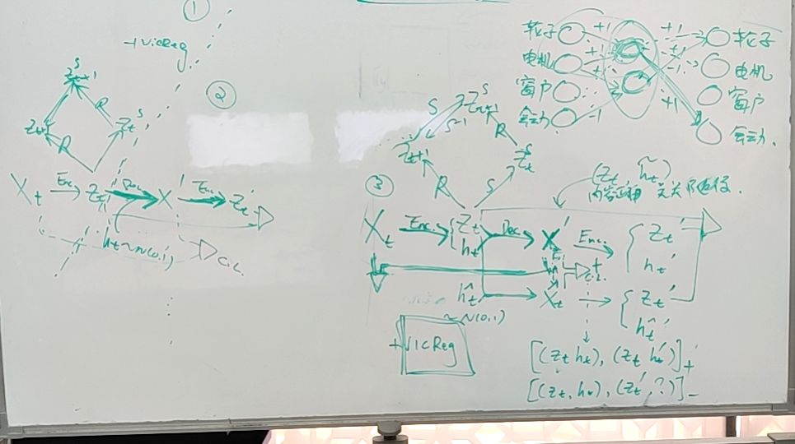

Slide 34
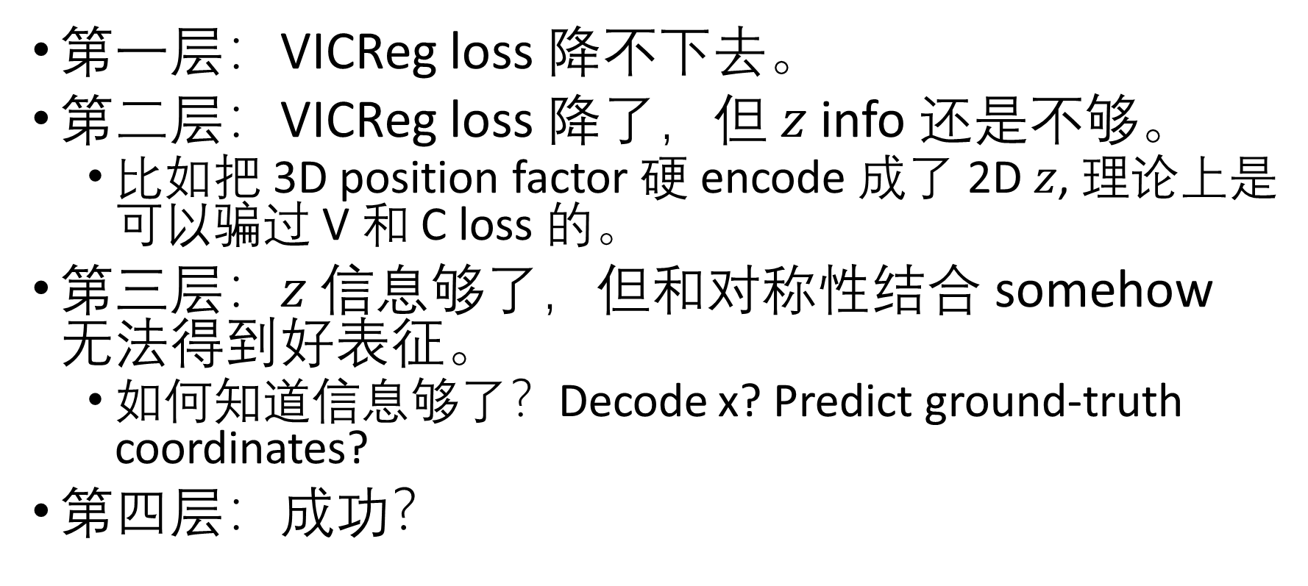
对称性+VICReg 实验结果
第一层：VICReg loss 降不下去。
第二层：VICReg loss 降了，但 $z$ info 还是不够。
比如把 3D position factor 硬 encode 成了 2D $z$, 理论上是可以骗过 V 和 C loss 的。
第三层：$z$ 信息够了，但和对称性结合 somehow 无法得到好表征。
如何知道信息够了？Decode x? Predict ground-truth coordinates?
第四层：成功？

